Slide 2


Climate Change:
The Basics
What is climate change and
why is it happening?

Slide 3
Questions I hope to answer…
What is the difference between the greenhouse effect, climate change and global warming?
What proof do we have that climate change is happening?
Why is it happening?

Slide 4
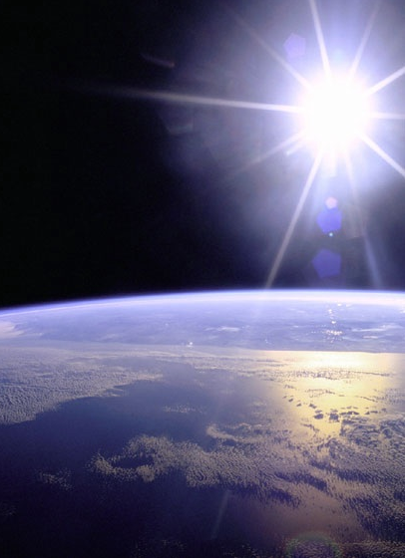
The Greenhouse Effect
The Earth is surrounded by a thin layer of gasses we call greenhouse gases. These gases are what make up our atmosphere.
Source: NASA

Slide 5
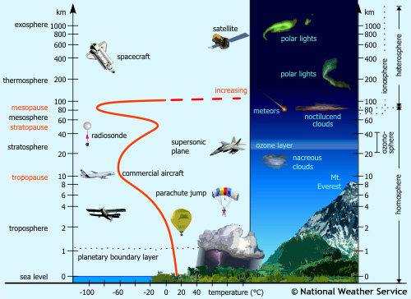
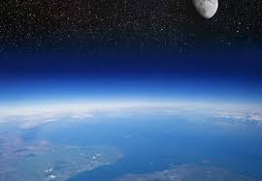
The Greenhouse Effect
Source: NASA

Slide 6
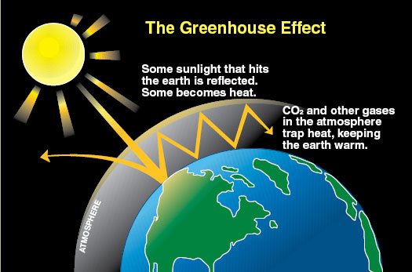
Notes:
Source: Climate Commission http://www.climatecouncil.org.au/

Slide 7
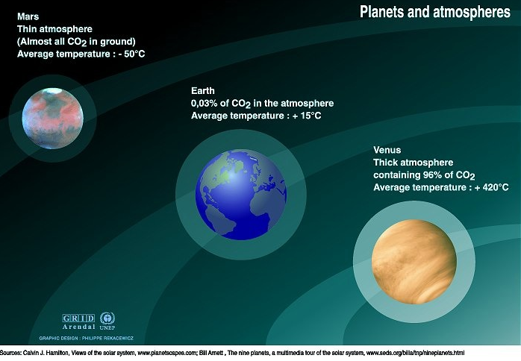
    The thickness of the atmosphere and the
    concentration of its gases influence the surface
    temperature on any planet.
Source: Climate Generation, Elizabeth Andre

Slide 8
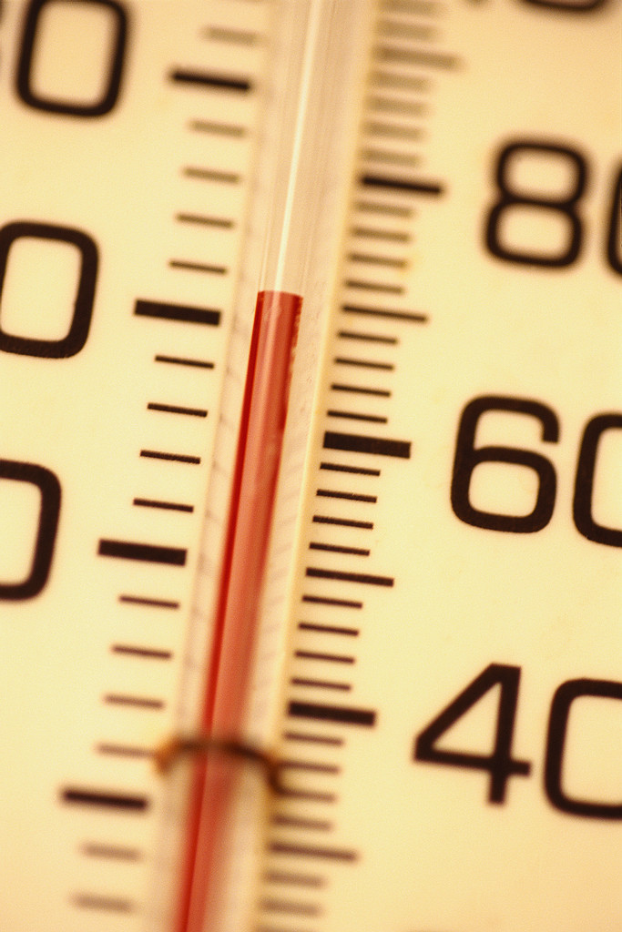
What’s the difference?
GLOBAL WARMING
Is the increase of the Earth’s average surface temperature due to a build-up of greenhouse gases in the atmosphere.
CLIMATE CHANGE
Is the long-term changes in climate, including average temperature and precipitation. It recognizes that, although the average surface temperature may increase, the regional or local temperature may decrease or remain constant.
© 2007National Wildlife Federation

Slide 9
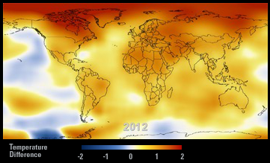
This map shows the five-year average variation of
global surface temperatures from 1884 to 2012.
Dark blue indicates areas cooler than average.
Dark red indicates areas warmer than average.
Source: NASA Climate http://climate.nasa.gov/key_indicators#globalTemp
Notes:
Visit NASA for an interactive tool about average variation in surface temperature! http://climate.nasa.gov/key_indicators#globalTemp

Slide 10

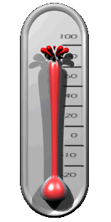



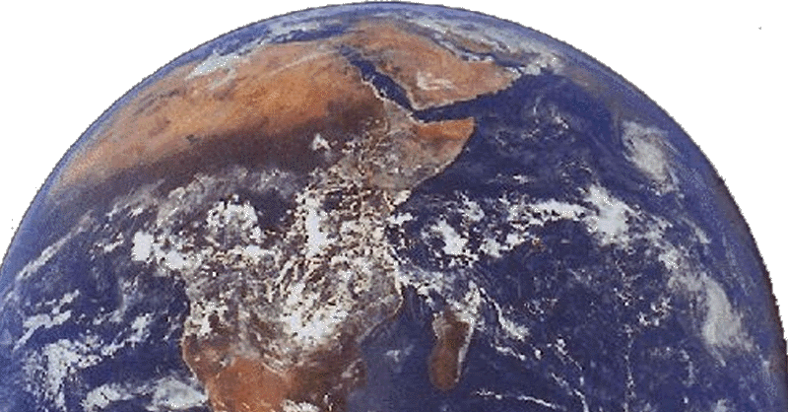
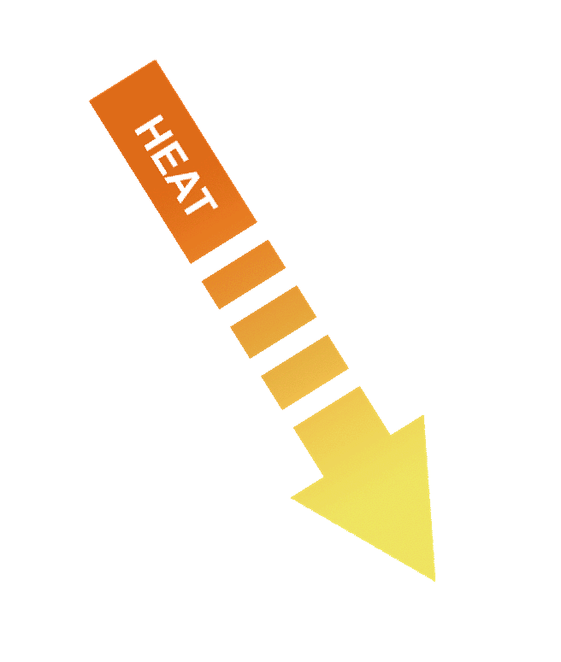
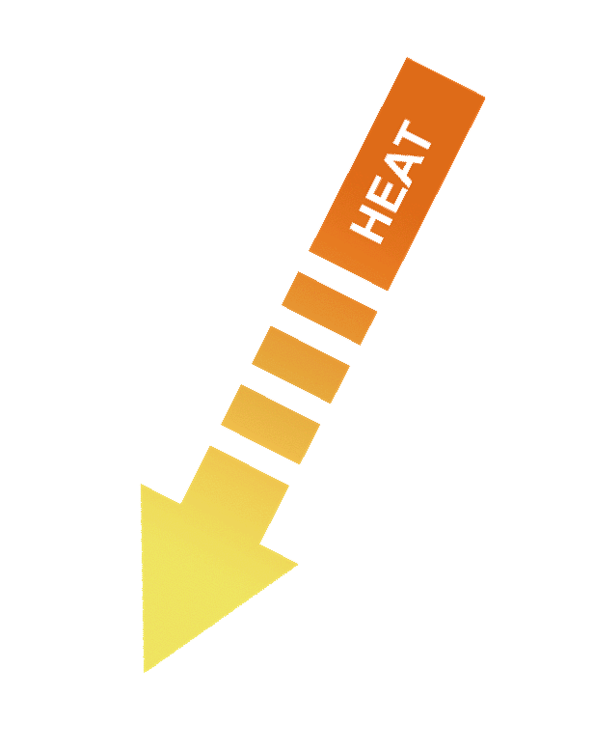
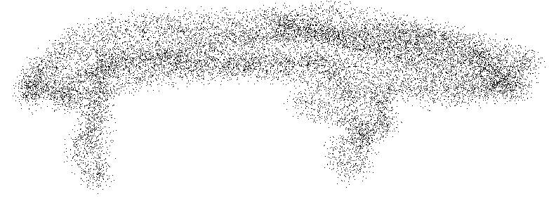
How Global Warming Works
Carbon Dioxide (CO₂)
Fossil fuels (coal, oil, natural gas)
© 2007National Wildlife Federation

Slide 11
What proof do we have?

Slide 12
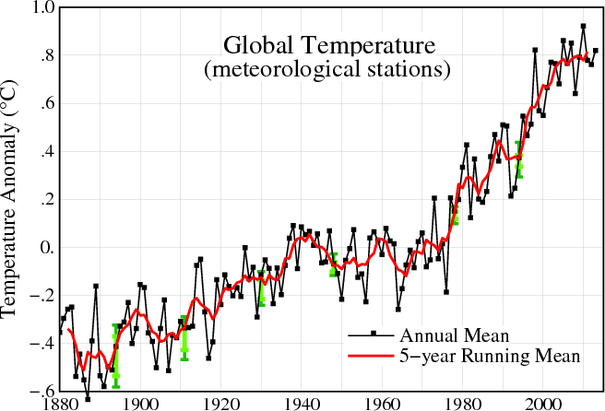
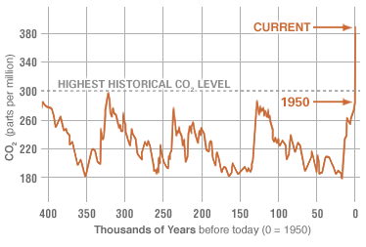
Temperature & CO₂ Data
Source: NASA Goddard Space Flight Center http://data.giss.nasa.gov/gistemp/graphs_v3/
Source: NASA Climate, Data from NOA http://climate.nasa.gov/key_indicators#co2

Slide 13
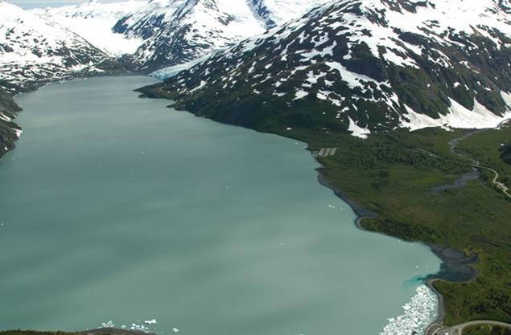
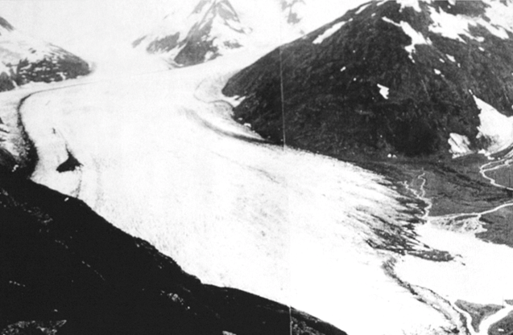
Glaciers are melting
So are ice caps on both North and South poll. Pictured example: Portage Glacier, Alaska
2004
1914

Slide 14
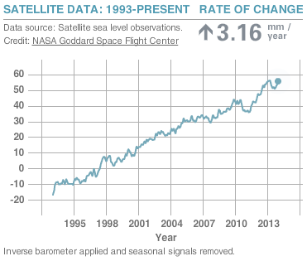
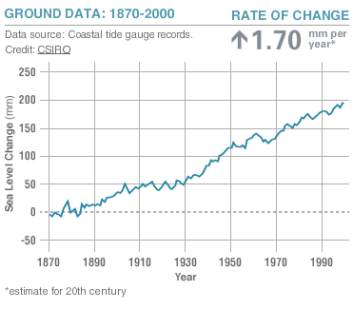
Global Sea Level Rise
Visit: http://climate.nasa.gov/key_indicators for interactive charts on sea level and other key climate change indicators.
Source: NASA Climate http://climate.nasa.gov/key_indicators#seaLevel
Notes:
Sea level rise is caused by two factors related to global warming: the added water coming from the melting of land ice, and the expansion of sea water as it warms up. The above graphs show how much sea level has changed since 1993 (right, satellite data record) and about 1880 (left, coastal tide gauge data).

Slide 15
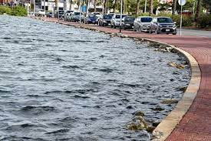

Slide 16
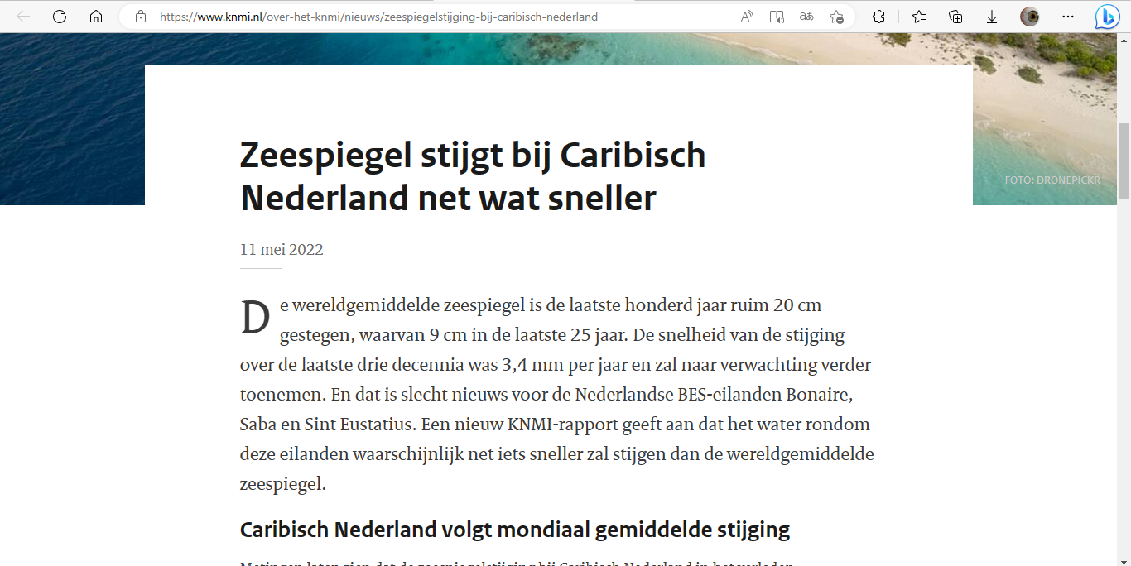

Slide 17
(1) See what three degrees of global warming looks like – YouTube
(1) Causes and Effects of Climate Change | National Geographic - YouTube

Slide 18
Climate Change
Temperatures are rising, especially in winter.
Extreme rainfall and flooding events (24-hr and 7-day) are more frequent.
Extreme droughts and massive wildfires are more common
In rural communities, forests and farmland are impacted, making crops and food more scarce and expensive for all.
Source: National Climate Assessment: http://nca2014.globalchange.gov/highlights/regions/rural-communities
Notes:
Brainstorm a list of how this might effect the United States. Be sure to include wildlife, tourism/recreation, agriculture, and human health. The examples on this slide are some of the most obvious.

Slide 19
Why is climate change happening?

Slide 20
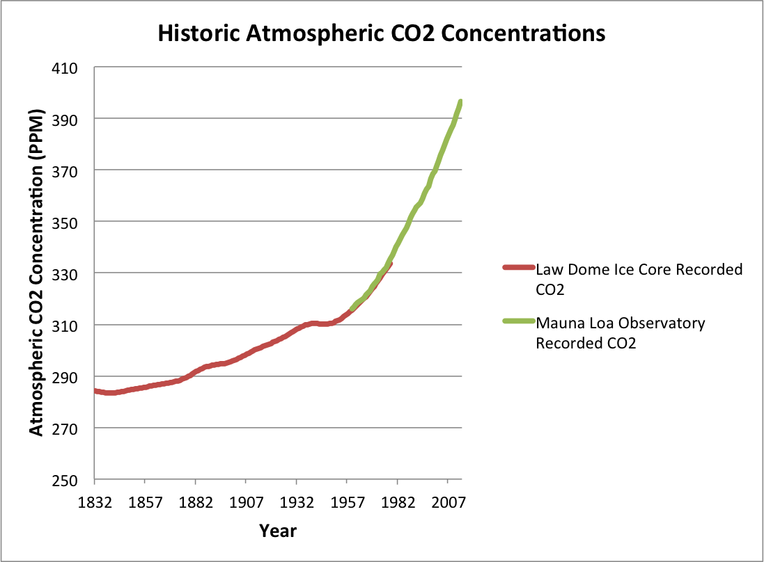
Sources:
- Mauna Loa Observatory, NOAA: ftp://aftp.cmdl.noaa.gov/products/trends/co2/co2_annmean_mlo.txt
- Law Dome Ice Core, Carbon Dioxide Information Analysis Center: http://cdiac.ornl.gov/ftp/trends/co2/lawdome.combined.dat
Notes:
Atmospheric CO2 has increased from a pre-industrial concentration of about 280 ppm to about 400 ppm in 2014 (ppm= parts per million). CO2 concentration data from before 1958 are from ice core measurements taken at the Law Dome in Antarctica and from 1958 onwards are from the Mauna Loa measurement site in Hawaii. CO2 Concentrations actually fluctuate up and down throughout the year – these lines are smooth because they show the yearly average. It is evident that the rapid increase in CO2 concentrations has been occurring since the onset of industrialization. The increase has closely followed the increase in CO2 emissions from fossil fuels.

Slide 21
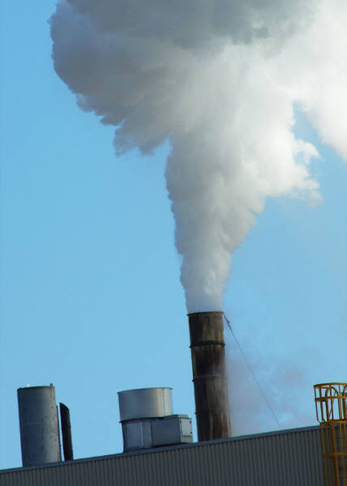
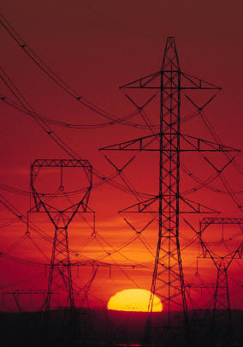
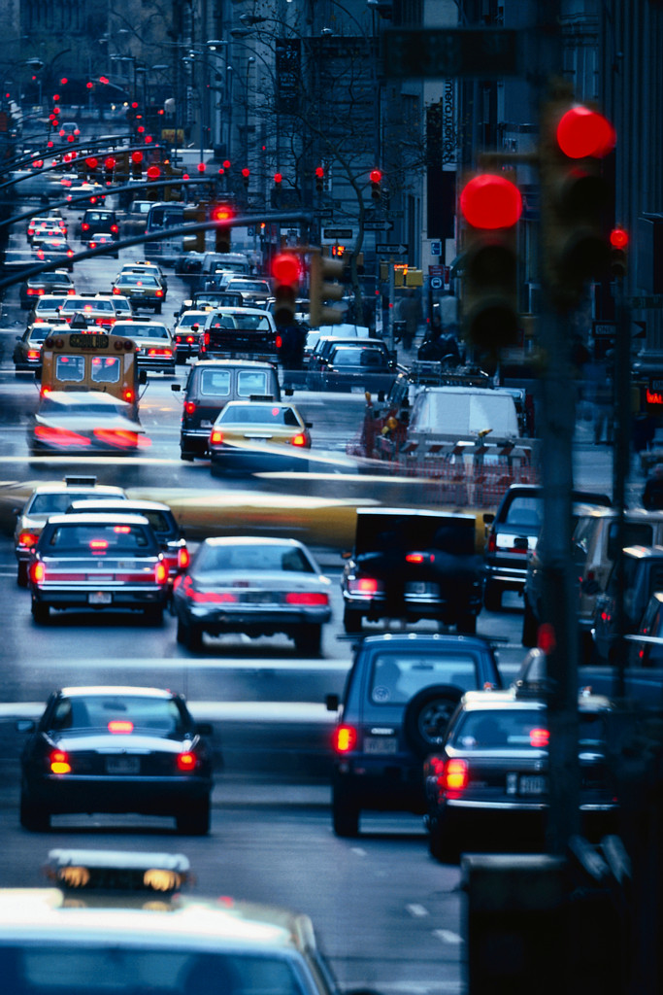
Pollution from coal, natural gas, and oil
Pollution from coal, natural gas, and oil
Pollution from coal, natural gas, and oil

Slide 22
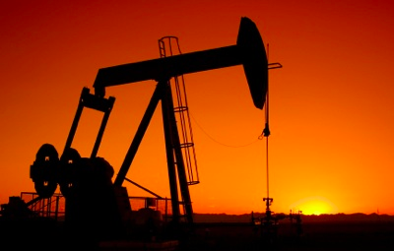
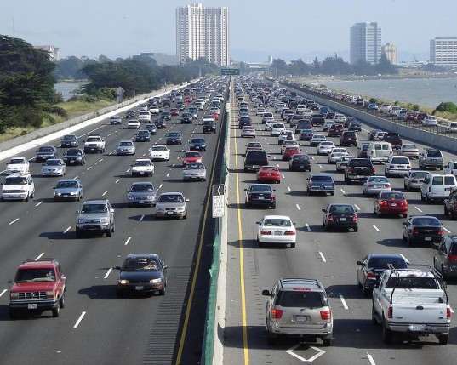
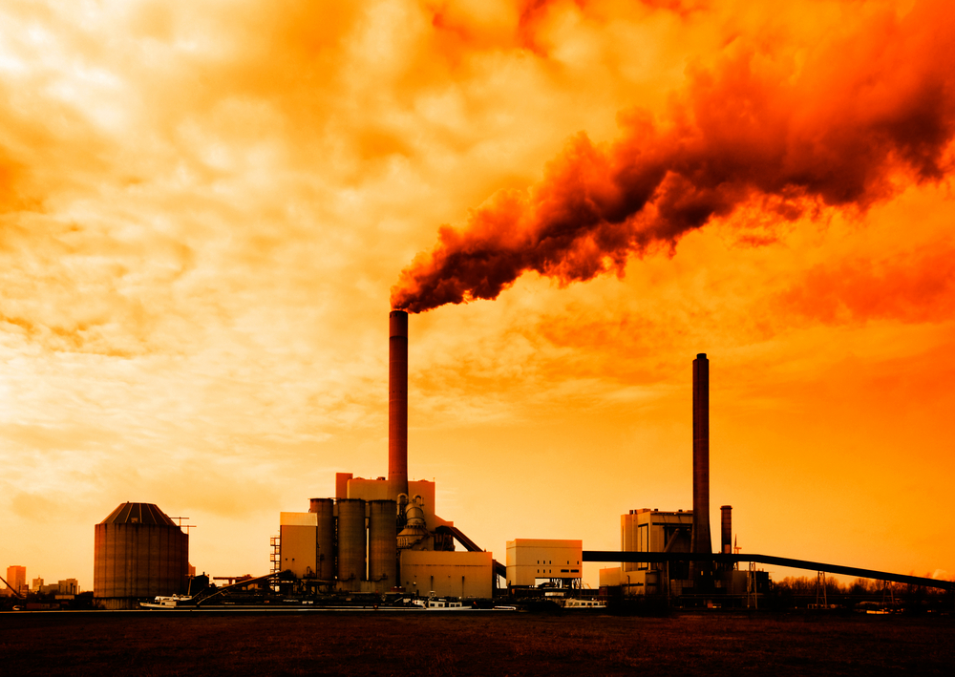
“Warming of the climate system is unequivocal,
human influence on the climate system is clear …”
- The Intergovernmental Panel on Climate Change, January, 2014, Press Release
Notes:
Quote Source: Intergovernmental Panel on Climate Change Press Release, January 30th 2014: http://www.ipcc.ch/pdf/press/press_release_wg1_full_report.pdf

Slide 23
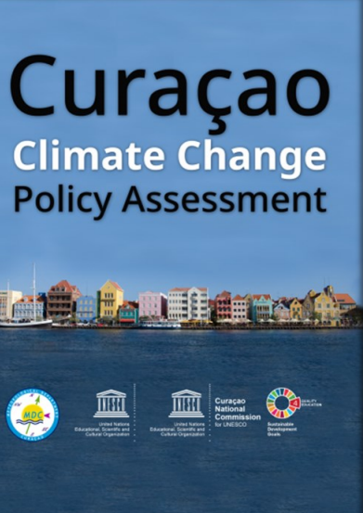
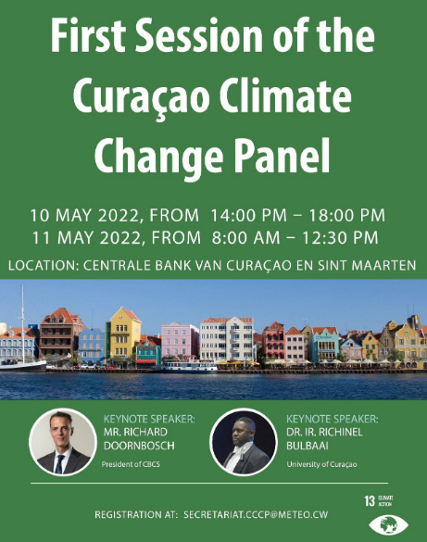

Slide 24
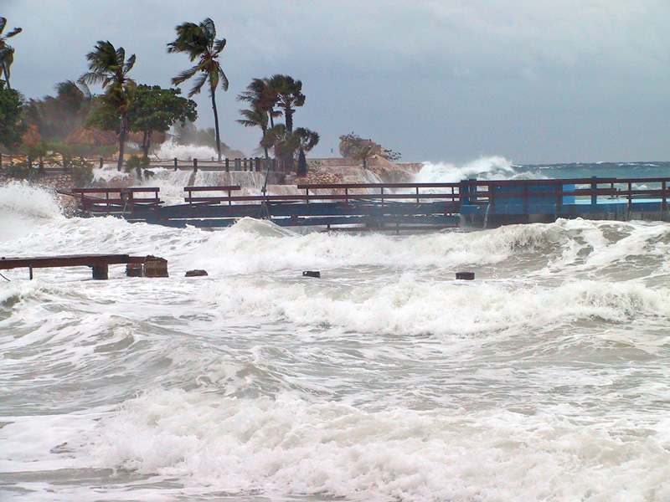

Slide 25
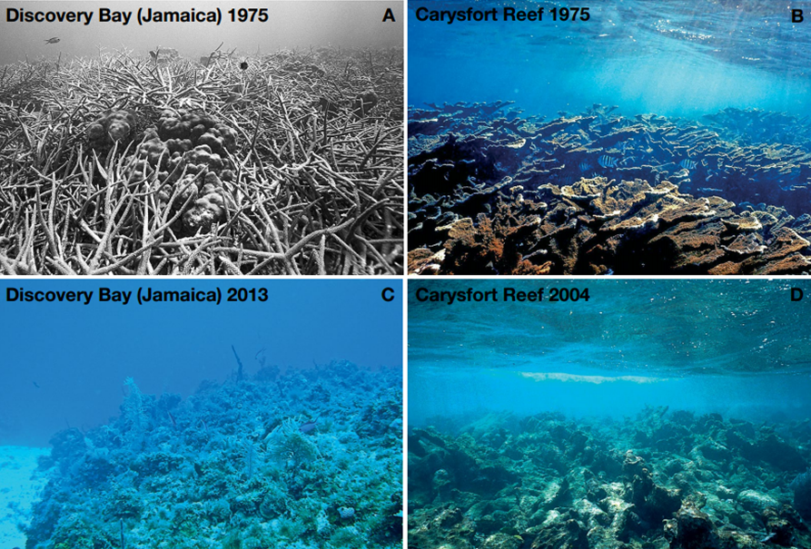

Slide 26
